Slide 1


The Maryland
Flipped Classroom Study for Higher Education
Dr. Timothy McWhirter
Project Director
Professor of Philosophy
Montgomery College Rockville Campus, MT 404
timothy.mcwhirter@
montgomercollege.edu
240.567.8026
Prof. Jennifer Capparella, Professor of Biological Sciences, Germantown
Dr. Mary Robinson, Chair, Department of English
and Reading, Germantown
Introduction
Notes:
The Seminar College Consortium Project
Teaching in a Digital Age

Slide 2
Will provide unique opportunities for you and your institution
Notes:
Technology is transforming professions all around the world.

Slide 3

What is flipping the classroom?

Slide 4
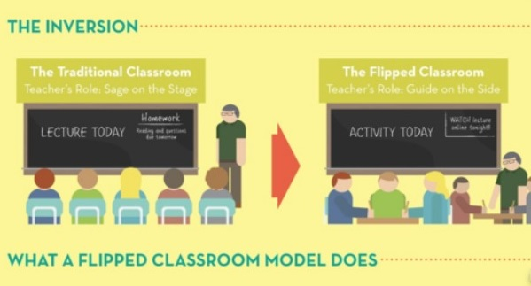
Flipping the Classroom
Expositions are recorded and watched at home or when needed.
  Videos and/or narrated slide presentations.
Homework is done during contact hours with instructor’s guidance.
  Instructor acts as:
    “Guide on the Side”
    not “Sage on the Stage”

Slide 5

What is The Maryland Flipped Classroom Study for Higher Education?
Faculty members across the state work together to form the largest study on flipped classrooms ever done.
We seek grant funding from or own institutions.
We seek grant funding, corporate sponsorships and donations as a group.
The funding is used to provide faculty members the:
  reassigned time
  Support
  Resources
  financial incentive to flip their classes

Slide 6
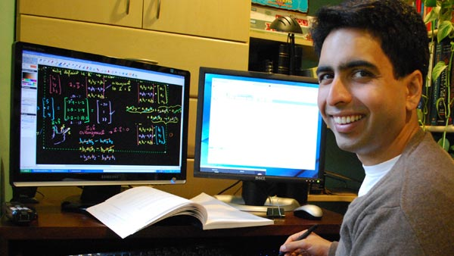

Digital Lecture in Information Age
Khan Academy
  Sal Khan’s cousins preferred to be tutored by video.
    They could control delivery of content.
  The Khan Academy has been used to flip classes all around the country.

Slide 7
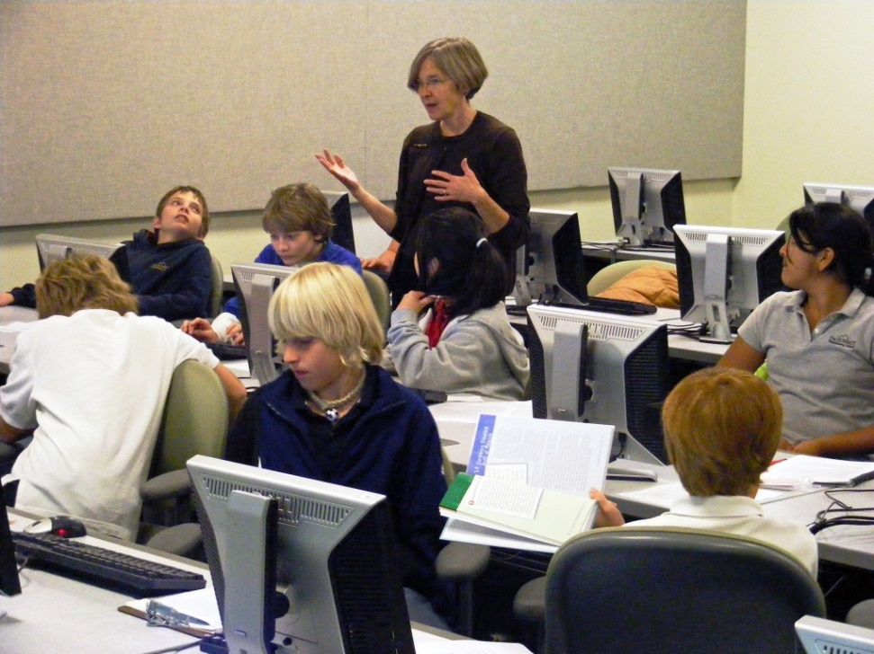
More Interaction
More exposition is reviewed at home.
Contact hours are used to work with students addressing limits in their understanding and developing higher levels of understanding.
  Helping with homework

Slide 8
More Interaction
Constructivist models of learning describe knowledge being developed through discussion.
  Answering questions through dialogue enables instructors to better understand and address student limitations.

Slide 9
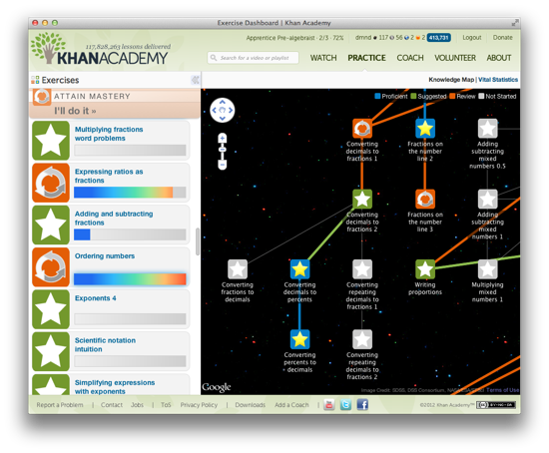
Learning Management Systems
Instructor monitors homework.
  Helps the students who need it where and when they need it.

Slide 10
Advantages of Flipping
Students can pause and rewind the professor.
Increases student/teacher interaction during contact hours and enhances their efficiency.
Enhances differentiated learning.
Speaks the digital language of today’s students.

Slide 11
It’s a Flipping Revolution
Convene — Flipping the Classroom for Meetings, Barbara Palmer, Convene Magazine, December 31, 2013
Why 86% of UN-Chapel Hill Students Prefer the Flipped Classroom, Jimmy Daly, EDTECH HigherEd, December 18, 2013
Education Reform has to Begin in the ‘Flipped Classroom,’ Suthichai Yoon, The Nation, December 19, 2013
How one school turned homework on its head with ‘flipped’ instruction, by Mike Fritz, PBSNewshour, December 5, 2013
How ‘Flipped Classrooms’ are turning the traditional school day upside down, PBSNewshour, December 11, 2013
It’s a Flipping Revolution, by Steven Neshyba, Chronicle of Higher Education, April 4, 2013
How Flipping the Classroom Can Improve the Traditional Lecture, by Dan Berrett, Chronicle of Higher Education, February 19, 2012
Inside the Flipped Classroom, by Katherine Mangan, Chronicle of Higher Education, September 30, 2013
Why 86% of UNC – Chapel Hill Student Prefer the Flipped Classroom, Jim Daley, Edtech HigerEd, December 13, 2013
‘”Foundations of Flipped Learning” Named Top Product of 2013 by School Administrators,’ Lisa Wolfe, PRWEB, December 29, 2013
Flippped Classroom may not have an impact on learning, Emily Attebury, USAToday, December 5, 2013.
Colleges Looking Beyond the Lecture, Mark Gail, Washington Post, February 15, 2012
Flipped Classroom Model not Like Flipping a Switch, Gary L. Smith, Journal Star, December 15, 2013

Slide 12

Studies
Harvey Mudd College Study
  2 Professors in Pilot
  4 in body of study
  Small size limits
  utility of data

Slide 13
Press for Harvey Mudd College Study
Flipped classroom signifies progressive shift, Erin Rode, Daily Trojan, December 3, 2014
Harvey Mudd among colleges experimenting with ‘flipped’ classes, Jason Song, Los Angeles Times, November 16, 2014
Taking a Page From Humanities, College Engineering Gets Flipped, Allie Bidwell, U. S. News and World Report, August 5, 2014
Harvey Mudd Professors to Study “Flipped” Classroom Model, Harvey Mudd College, September 16, 2013
Still in favor of the Flip,Carl Straumsheim, Inside HigherEd, October 13, 2013
A Response to USA Today Article on Flipped Classroom Research, Phil Hill, e-Literate, October 22, 2013
“QuickWire: ‘Flipping’ Classrooms May Not Make Much Difference” Hannah Winston, The Chronicle of Higher Education, October 22, 2013
Recording a lecture does not equal flipping a classroom, WordSpring, October 22, 2013
A LITTLE FLIP FLAP, Peter Goodman, Hofstra AAUP, October 26th, 2013.
Flipped classroom courses create same results as traditional classes, Colleen Fell, Daily Nebraskan, October 30th, 2013
Still in Favor of the Flip, Carl Straumsheim, Inside Higher Ed, October 30, 2013
New Study from Harvey Mudd Calls Out Flipped Classroom Ineffectiveness, edSurge, November 2, 2013
Flipping the Classroom Facilitate Active Learning Methods – Experiential, Project Based, Problem Based, Inquiry Based, Constructivism, Etc., Kelly Walsh, EmergingEdTech, November 3, 2013
From Flipped Classrooms to Flipping with Peer Instruction, Julie Schell, Turn to Your Neighbor, November 4, 2013
Is the Flipped Classroom a Flop?, J Cohen, World Education.net, November 8, 2013
The “Flipped Classroom” and its implications for Maritime Training, Murray Goldberg, Maritime Professional, November 11, 2013
Why Flipping Classrooms Might Not Make Much Difference, Computing Education Blog, November 13, 2013
The Flipped Classroom: Darling or Dud?, Evy Schwartz, IBM Training Blog, November, 27, 2013. | 2013-11-27
‘Flipped Classrooms’ may not have any impact on learning, Emily Atteberry, USAToday, December 5, 2013

Slide 14
Press for Harvey Mudd College Study
Is Flipped Education Worth Flipping For?, Nancy Caramanico, K-12 Blueprint, December 29, 2013
Flipped Classroom Method Wins Attention as One of the World’s Most Innovative Teaching Methods, Plante Moran, January 17, 2014
Assessing the Flipped Classroom’s Impact on Learning, David Rath, Campus Technology, January 22, 2014.
At Ed-Tech Conference, Midwestern Educators Will Explore The Flip, Tim Lloyd, St. Louis Public Radio, February 9, 2014
The Flipped Classroom. A disruptive revolution in pedagogy, or yet another educational fad?, Rebecca Schuman, Slate, February 19, 2014
Does the Flipped Classroom Improve Student Performance?, Randy Matusky, Diary of a Learner, March 11, 2014
Can Flipped Classrooms Help Students Learn? We are trying to find out, Nancy Lape, Rachel Levy, and Darryl Yong, Slate Magazine, April 25, 2014.
Flipped learning skepticism: Is flipped learning just self-teaching?, Robert Talbert, The Chronicle, April 28, 2014
The fallacy of evaluating “the flipped class.” Jung’s Biology Blog, April 28, 2014
Flipped Classrooms: Just a Fad?, Rebecca Bridges, The Know How of Writing Online, July 21, 2014
The Flipped Classroom May Help Weaker STEM Students, Allie Bidwell, U. S. News and World Report, August 5, 2014.
Up for Debate: Should Schools Implement the ‘Flipped Teaching’ Method?, Neil Gupta, Cogito, August, 4, 2014.
Flipping the classroom: Physics Prof. Tim Good uses technology to engage students with classwork, News at Gettysburg, August 11, 2014
Up for Debate: Should Schools Implement the ‘Flipped Teaching’ Method?, Neil Gupta, Cogito, August 4, 2014
Flipped Learning Can Flip Results in High Education, Adrian Thompson, Pearson, August 26, 2014
UFIT offers seminar to show faculty how to flip teaching classroom method, Damaris Lopex, Alligator, September 24, 2014
Villanova: Improved student performance in ‘flipped’ classes, Susan Snyder ,Philadelphia Inquirer, September 28, 2014
HMC Flipped Classroom Study Shows No Difference, Han Jia, The Student Life, Oct 3, 2014

Slide 15

First Opportunity
1. Create a study of flipped classrooms that has a representative sample size.
  The Law of Large Numbers
  Instead of six faculty members a study that never ends.

Slide 16
Flipped Study Team
Dr. Timothy McWhirter, Professor of Philosophy, Rockville Campus
Prof. Judith Stone, Professor of Art, Rockville Campus
Dr. Joanne Bagshaw, Professor of Psychology, Germantown
Dr. Amanda Truett, Professor of Environmental Science, Takoma Park/Silver Spring
Prof. Cristina Daley, Professor of Spanish, Rockville
Prof. Anestine Theophile-LaFond, Communication Studies, Rockville
Dr. Hossein S. Seifzadeh, Adjunct Professor of Politics, Rockville
Dr. Monica Zhang, Adjunct Professor of Chinese, Rockville Campus
Prof. Carla Best-Otubu, Assistant Professor of Nursing, Takoma Park/Silver Spring
Prof. Matthew Ratz, Adjunct Professor of English, Rockville
Prof. Jennifer Capparella, Assistant Professor Biological Sciences, Germantown
Dr. Jason Lee, Associate Professor, Mathematics, Rockville
Dr. Mary E. Hopkins, Professor, Mathematics, Rockville
Prof. Tendai Johnson, Professor of Art, Rockville
Dr. Agnes Conaty, Adjunct Professor of Mathematics, Rockville
Dr. Leah Allen, Associate Professor of Biology, Rockville Campus

Slide 17
Flipped Study Team
Dr. Rita Kranidis, Professor of Humanities, Takoma Park/Silver Spring
Dr. Maria-Elvira Luna-Escudero-Alie, Professor of French and Spanish, Takoma Park
Prof. Carla Isabel Naranjo, Associate Professor of Spanish, Germantown
Prof. Pauline Laster, Associate Professor of Sign Language, Rockville
Dr. Syed A. Wasif, Adjunct Professor of Political Science, TP/SS Campus
Dr. Mary Robinson, Chair, Department of English and Reading, Germantown
Dr. Spencer Cosmos, Adjunct Professor of English, Rockville
Prof. Chris Koch, Professor of Television, Rockville
Dr. Jeanann Boyce, Professor of Business, TP/SS Campus
Dr. Sadi Sahbazian, Professor of AELP, TP/SS
Prof. Hannah Leatherbury, Adjunct Professor of Yoga, TP/SS Campus
Dr. Mohibulla N. Durrani, Adjunct Professor of Engineering, Rockville Campus
Dr. Robin Vaughn Hirshorn, Adjunct Professor of Biology, Rockville Campus
Dr. Deborah Taylor, Adjunct Professor, TPSS Campus
Dr. Virginia Lea Miller, Associate Professor of Chemistry, Rockville Campus
Dr. Michael LeBlanc, Associate Professor of English, TP/SS CampusDr. Abdirisak Mohamed, Adjunct Professor of Mathematics, Germantown Campus
Prof. Mary Wall, Adjunct Professor of Mathematics, TP/SS Campus

Slide 18
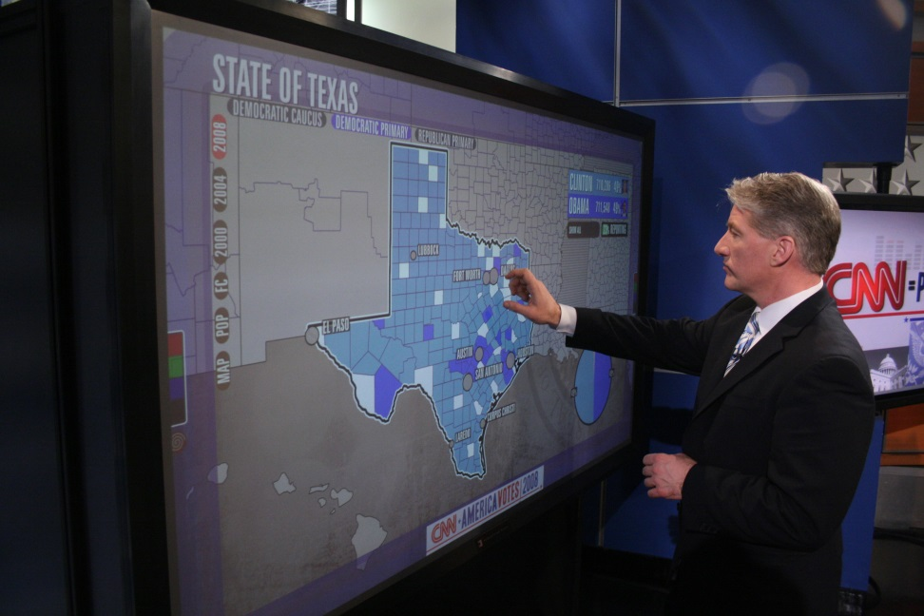
Second Opportunity
2. Seek grant funding and corporate sponsorships to fund the study.
  We can be confident it will be covered by the press.
  We can therefore provide unsolicited advertising for all the products we use.
    Lync Room Systems

Slide 19

Third Opportunity
3. Use these resources to address the obstacles to flipping the classroom.

Slide 20
Obstacles to Flipping
Ryan Craig, Wired, October 27, 2014
Faculty
  Need reassigned time and support.
Architecture
  Rooms made for lectures.
Students
  Are accustomed to the lecture model.

Slide 21
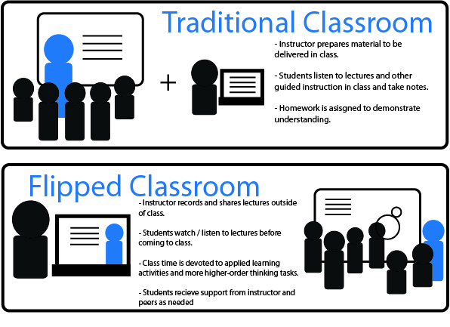
Serial Attendance Model
Total attendance model based on lecture.
Flipped Classroom
  Opens up the possibility for group activities during contact hours.
  Serial Attendance Model
    Small groups attend class during contact hours.

Slide 22
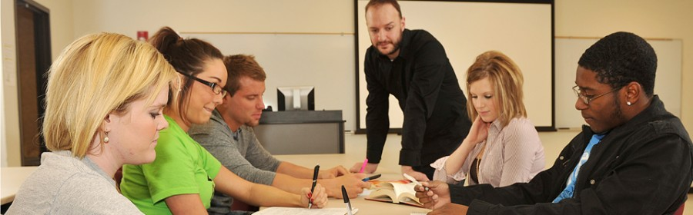
Serial Attendance Model
Florida International University
  Instructors met with students in 5 student conferences.
  Writing Program used approach from 1999-2005.
    Improved grades 25%
    Reduced plagiarism
    ESL issues handled more easily

Slide 23

Overcoming the Obstacles
Faculty:
Time off and Support
  Participants serve as
  paid consultants
Architecture:
Faculty offices redesigned
  For Flipped Serial courses
Students:
Lync Room Systems
  82 inch cell phones
  on the wall
    Educational Jujutsu

Slide 24

Perceptive Pixel Screens

Slide 25
Microsoft Lync Room Systems

Slide 26

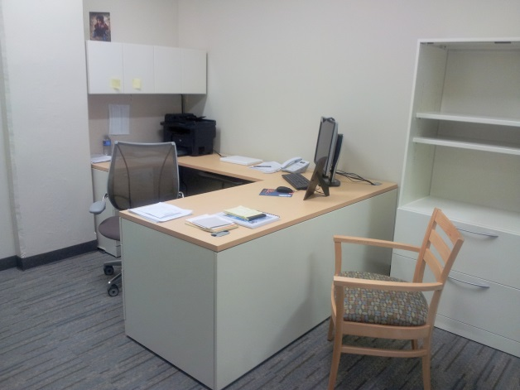
Fourth Opportunity
Allow Faculty members to flip to a serial attendance model where appropriate.
Pay for the redesign of the interior furniture of faculty offices to support student conferences.
Faculty Office
  The Low Hanging Fruit in Higher Education

Slide 27
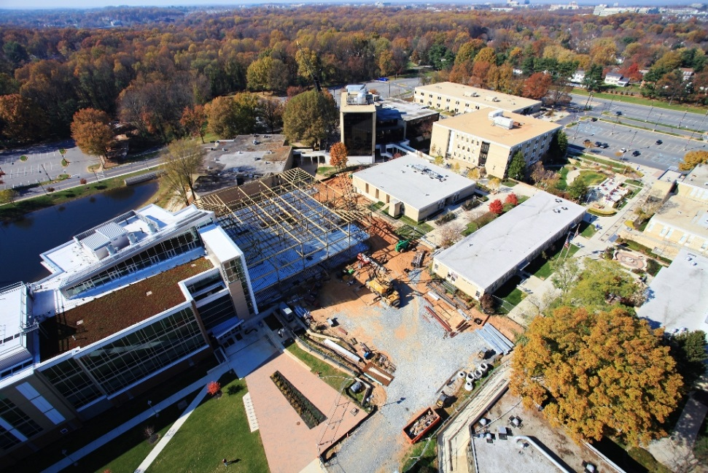
Saving Classroom Space
535 full time faculty at Montgomery College
  12 Humanities buildings.
    A new campus
2,229 full time college faculty in Maryland.
  50 Humanities buildings.
    Two colleges

Slide 28

The Maryland
Flipped Classroom Study
Pilot Phase
  Three faculty members from Montgomery College will flip their classes and teach them during the 2015/2016 academic year. They will be joined by faculty members from colleges across the state.
  The work will by funded by small grants at individual institutions.
  Courses will be assessed using a set of tools agreed upon by the members of the study and the information will be shared with the study team.
  Course materials will be posted online for others to use.
  Faculty members across the state who have already flipped their classes and are able to share assessment info will be asked to do so.

Slide 29

Funding
Institutional Grants
  MC Innovation Grants
    $30,000 a year
    Creating sustainable, systemic improvements to the college.
  Multiple Institutions
    1/2 of $30,000=$15,000
    16x$15,000=$240,000
    Harvey Mudd College Study cost @ $200,000

Slide 30
The Maryland
Flipped Classroom Study
Phase One
  In 2016, 20 to 40 faculty members from across the state will flip their classes and assess them.
  The work will be funded by small grants at individual institutions.
  Courses will be assessed using a set of tools agreed upon by the members of the study and the assessment information will be shared with the study team.
  Course materials will be posted online for others to use.

Slide 31

The Maryland
Flipped Classroom Study
Phase Two
  Phase One continues until the study team is able to receive multi-institutional grants or corporate sponsorships.
  Faculty members from different subject areas are provided reassigned time to redesign a course in the flipped format.
    The number of faculty members participating will depend on the amount of funding.
  Some of the faculty members’ offices will be redesigned.
  Courses will be assessed using an agreed upon set of instruments.
  Faculty members who have already participated will be eligible to serve as paid consultants: answer questions, share material, edit content.

Slide 32

Funding
Multi-institutional Grants
The Teagle Foundation
  Funded a $215,000 project for three years in 2014.
  Four Universities
    University of Kansas
    Park University
    Elon University
    Rockhurst University
  The project funds the development of flipped Humanities courses.

Slide 33

Funding
National Science Foundation
  Funded a $598,522 project for three years in 2013
  Four Institutions
    University of South Florida
    Arizona State University
    University of Pittsburgh
    Alabama A&M University
  For improving and assessing student learning in flipped STEM classrooms.

Slide 34
The Maryland
Flipped Classroom Study
Phase Three
  Phase Two continues until grant funding and/or a corporate sponsorship is secured that will finance phase three. The Gates Foundation and Microsoft are primary targets.
  Faculty members from different colleges in Maryland are provided reassigned time to redesign a course in the flipped format.
    The number of faculty members participating will be much larger than phase two.
  Some of the faculty members’ offices will be redesigned.
  Courses will be assessed using agreed upon instruments.
  Course materials will be posted online.
  Faculty members with experience flipping will be eligible to serve as paid consultants: answer questions, share material, edit content.

Slide 35
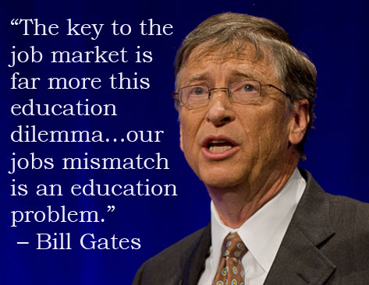
Funding
Gates Foundation
  Between 61 and 74 grants a year from 2010 to 2013.
  Up to $17,278,608
  In interviews, books and a last discussion with Steve Jobs, Gates envisions the flipped serial seminar.
    “with students watching lectures and video lessons on their own”
    the “efficiency of the face-to-face time” is increased through “group collaboration as opposed to the lecture.”
  Does not see Faculty Office

Slide 36
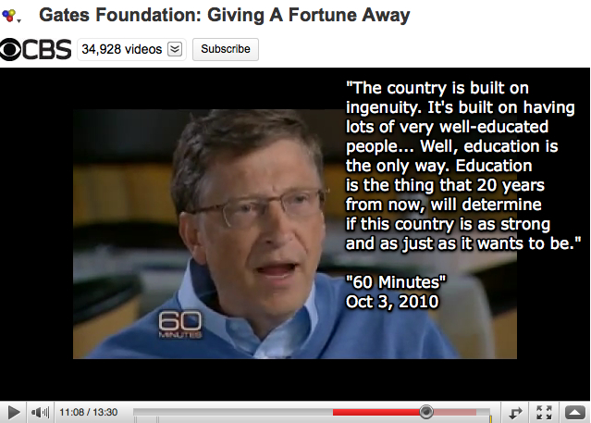
Funding
MIT, Bunker Hill Community College
  $1,120,153
  To develop an Introduction to Computer Science MOOC to be used in Flipped mode at the college.
  2013

Slide 37

The Maryland
Flipped Classroom Study
Phase Four
  Those who participate in the study will be able to form an Institute and provide these same services to the other states around the country:
    Increasing the effectiveness of higher education.
    Reducing its cost.
  Corporate Sponsorships

Slide 38

Opportunity for Faculty Members
Improve your student outcomes
Receive the resources to address the obstacles to flipping classrooms.
Earn extra money as paid consultant or supervisor
Help your college implement video conferencing centers that enable you to participate in meetings from your office or home.

Slide 39

Opportunities for Institutions
Participate in the first inter-institutional study of flipped classrooms that will not end.
Enable the state to open two colleges without building a building.
Dramatically increase the efficiency of college operations through the use of state-of-the art video conferencing technology.
  MC can save $2.4 million over 3 years

Slide 40
Interested?
Leave your contact info on our laptop.
Send us an email.
  timothy.mcwhirter@montgomerycollege.edu

Slide 41
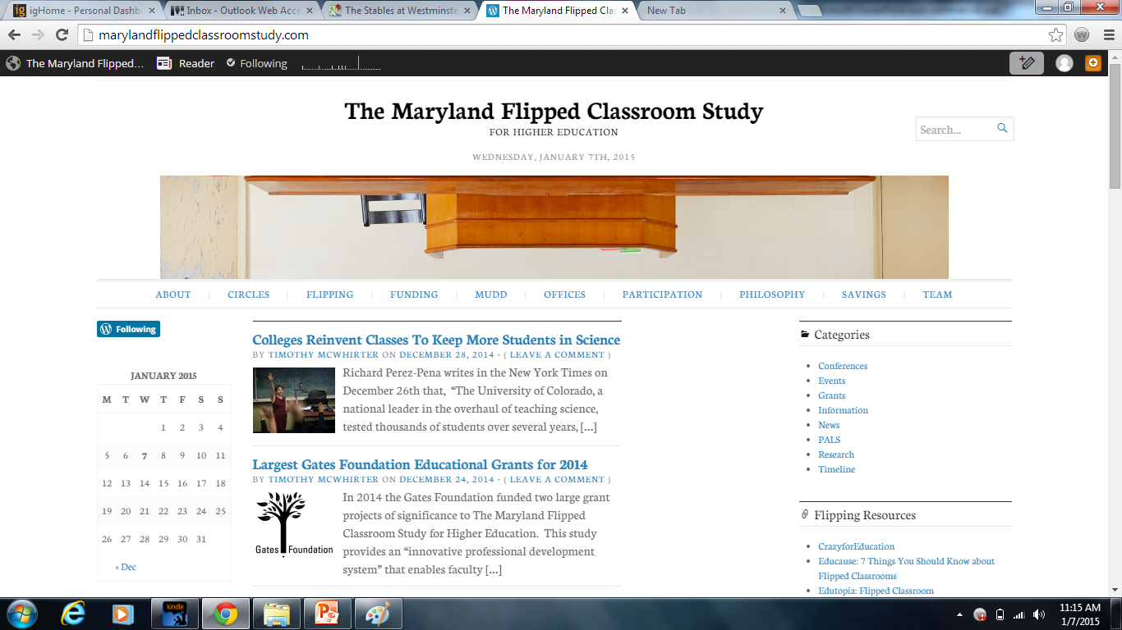
Timothy McWhirter, Ph. D.
Project Director, Professor of Philosophy
Montgomery College, Rockville Campus, MT 404
timothy.mcwhirter@montgomerycollege.edu
240.567.8026
Notes:
The Seminar College Consortium Project
Teaching in a Digital Age

